Slide 1

AVIATION-EDGE : Flight Tracking
By:
Julie, Giselle, Kelvin & Sharad

Slide 2

Aviation Edge Api

Slide 3

Key Features - Aviation Edge API:
Flight Data
Airline Information
Airport Information
Aircraft Information
Routes Information
Time zone and City Information
Aviation Edge is a provider of aviation-related data and services, offering APIs that allow developers to access a wide range of information related to the aviation industry.

Slide 4
Use Cases and Applications:
Flight Tracking Applications:
Developers can use the Aviation Edge API to build flight tracking applications that provide real-time information about flight positions, status, and schedules.
Travel Planning Tools:
Travel websites and applications can use the API to offer users information about airports, airlines, and flight schedules for travel planning purposes.
Aviation Analytics:
Analysts and researchers can leverage the API to gather data and insights for aviation-related research and analysis.
Airlines and Airport Services:
Airlines and airport service providers can use the API to obtain data about airports, airlines, and flights to enhance their services and operations.

Slide 5

An interactive Visual of Aviation Edge

Slide 6
Coding Approach
Utilise live API from Aviation – Edge : Json
D3 and Java Script
HTML
CSS file for styling

Slide 7
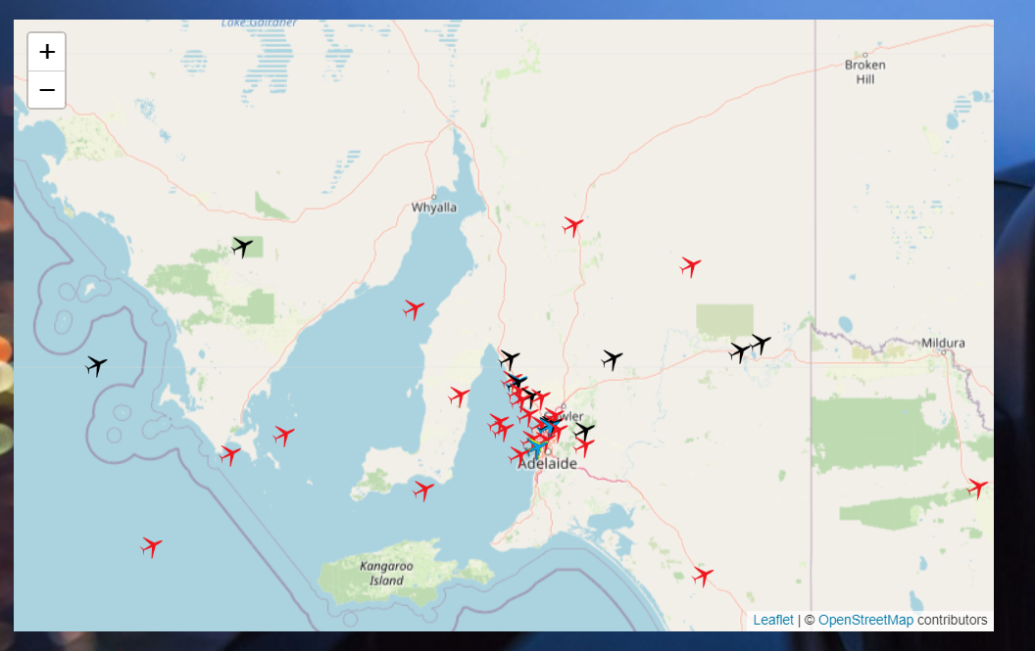
Landing page centered over South Australian airspace.

Slide 8

What does the airplane icon color mean?

Slide 9




Color icons represents airplane status / type
These are the flights in taxi
All landed aircrafts
All aircrafts with any other status, including non-commercial passenger planes
These are the flights en-route to destination

Slide 10

Select the airline from the drop down to find its entire operating fleet on your map.
Let's see how?

Slide 11
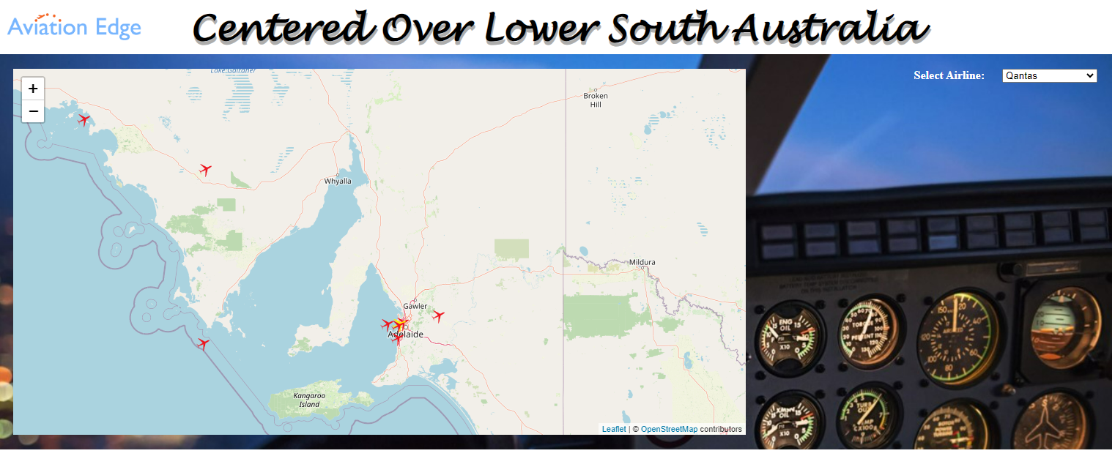
Select the airline from the top right corner and see the fleet yourself synchronizing based on the map area. Qantas example above*

Slide 12
Get more information on the airplane

Slide 13
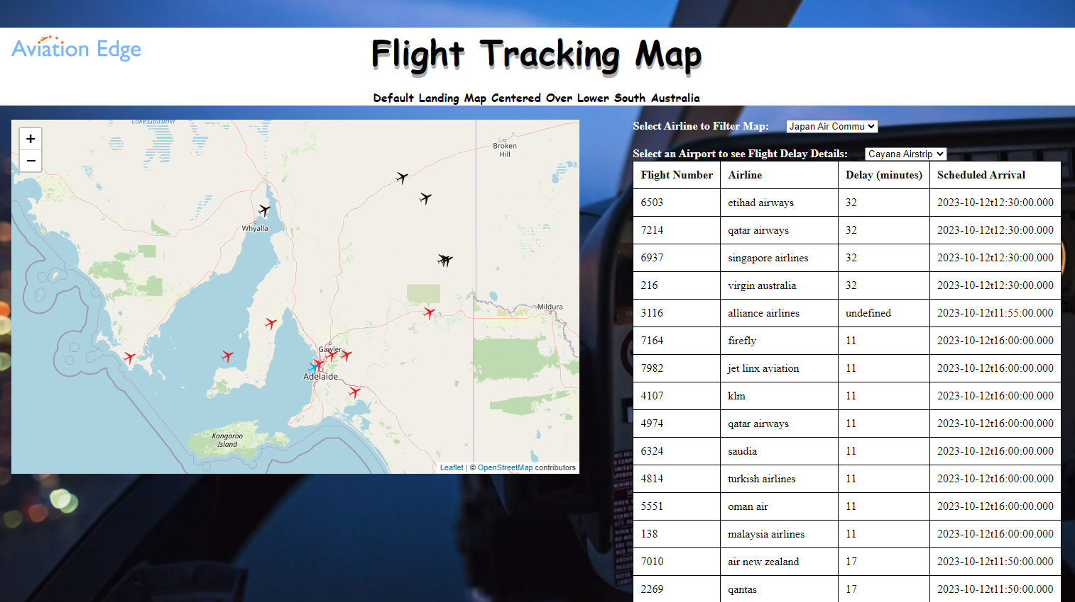
A table to show flight number, Airline, delays and the scheduled arrival time in the airspace selected. This can also be filtered at different airport level

Slide 14

Limitation and Recommendations
Rate Limits: APIs often have rate limits that restrict the number of requests a user can make within a given time frame (e.g., requests per minute, hour, or day). Exceeding these limits may result in temporary blocks or restrictions on further API usage.
Data Freshness: Real-time data might have a delay due to the processing and updating of information. Users should be aware of potential delays in receiving the most up-to-date information.
Limited Free Tier: The API may offer limited access or features under a free-tier plan, and users might need to subscribe to a paid plan for access to additional or advanced features.
Data Coverage: The API's coverage of certain data types (e.g., airports, airlines, flights) or geographical regions might be limited. Some data may be more comprehensive in certain areas compared to others.
Limited Customer Support for Free Tiers: Free-tier users might have limited access to customer support, and responses may take longer compared to paid users who typically receive higher priority support.

Slide 15

Thank You The crew is ready for questions.

